Slide 1
FuelMart & Subway Safety Committee Meeting
Wednesday, June 17, 2019
2:00 PM
Corporate Office Conference Room and GoTo Meeting Web Conference

Slide 2
1. Safety Topic – Heat Illness Prevention a. Heat exhaustion, Risk factors for heat illness, symptoms of heat exhaustion, Symptoms of heat stroke and info. To prevent heat illness. 2. FuelMart documents website is updated Monthly to include PowerPoint, Meeting minutes and the recording. 3. items discussed in open floor forum last month: A. FM 646 mentioned employees should consider wearing cool scarf to stay cool in hot weather B. Discussed what employees were doing to prevent injuries when using and cleaning knives at Subway locations.
May 2019 Review:

Slide 3
Incidents and Injuries From 05/12/2019 to 06/18/2019

Slide 4
Employee Injuries:
04/15/2019 - Last reported FM & Subway employee work-related injury. Employee bumped tomato slicing blade and cut left ring finger. First aid treatment only.
Corrective Action – Employee should have been wearing cut resistant gloves. Employee was re-trained.

Slide 5
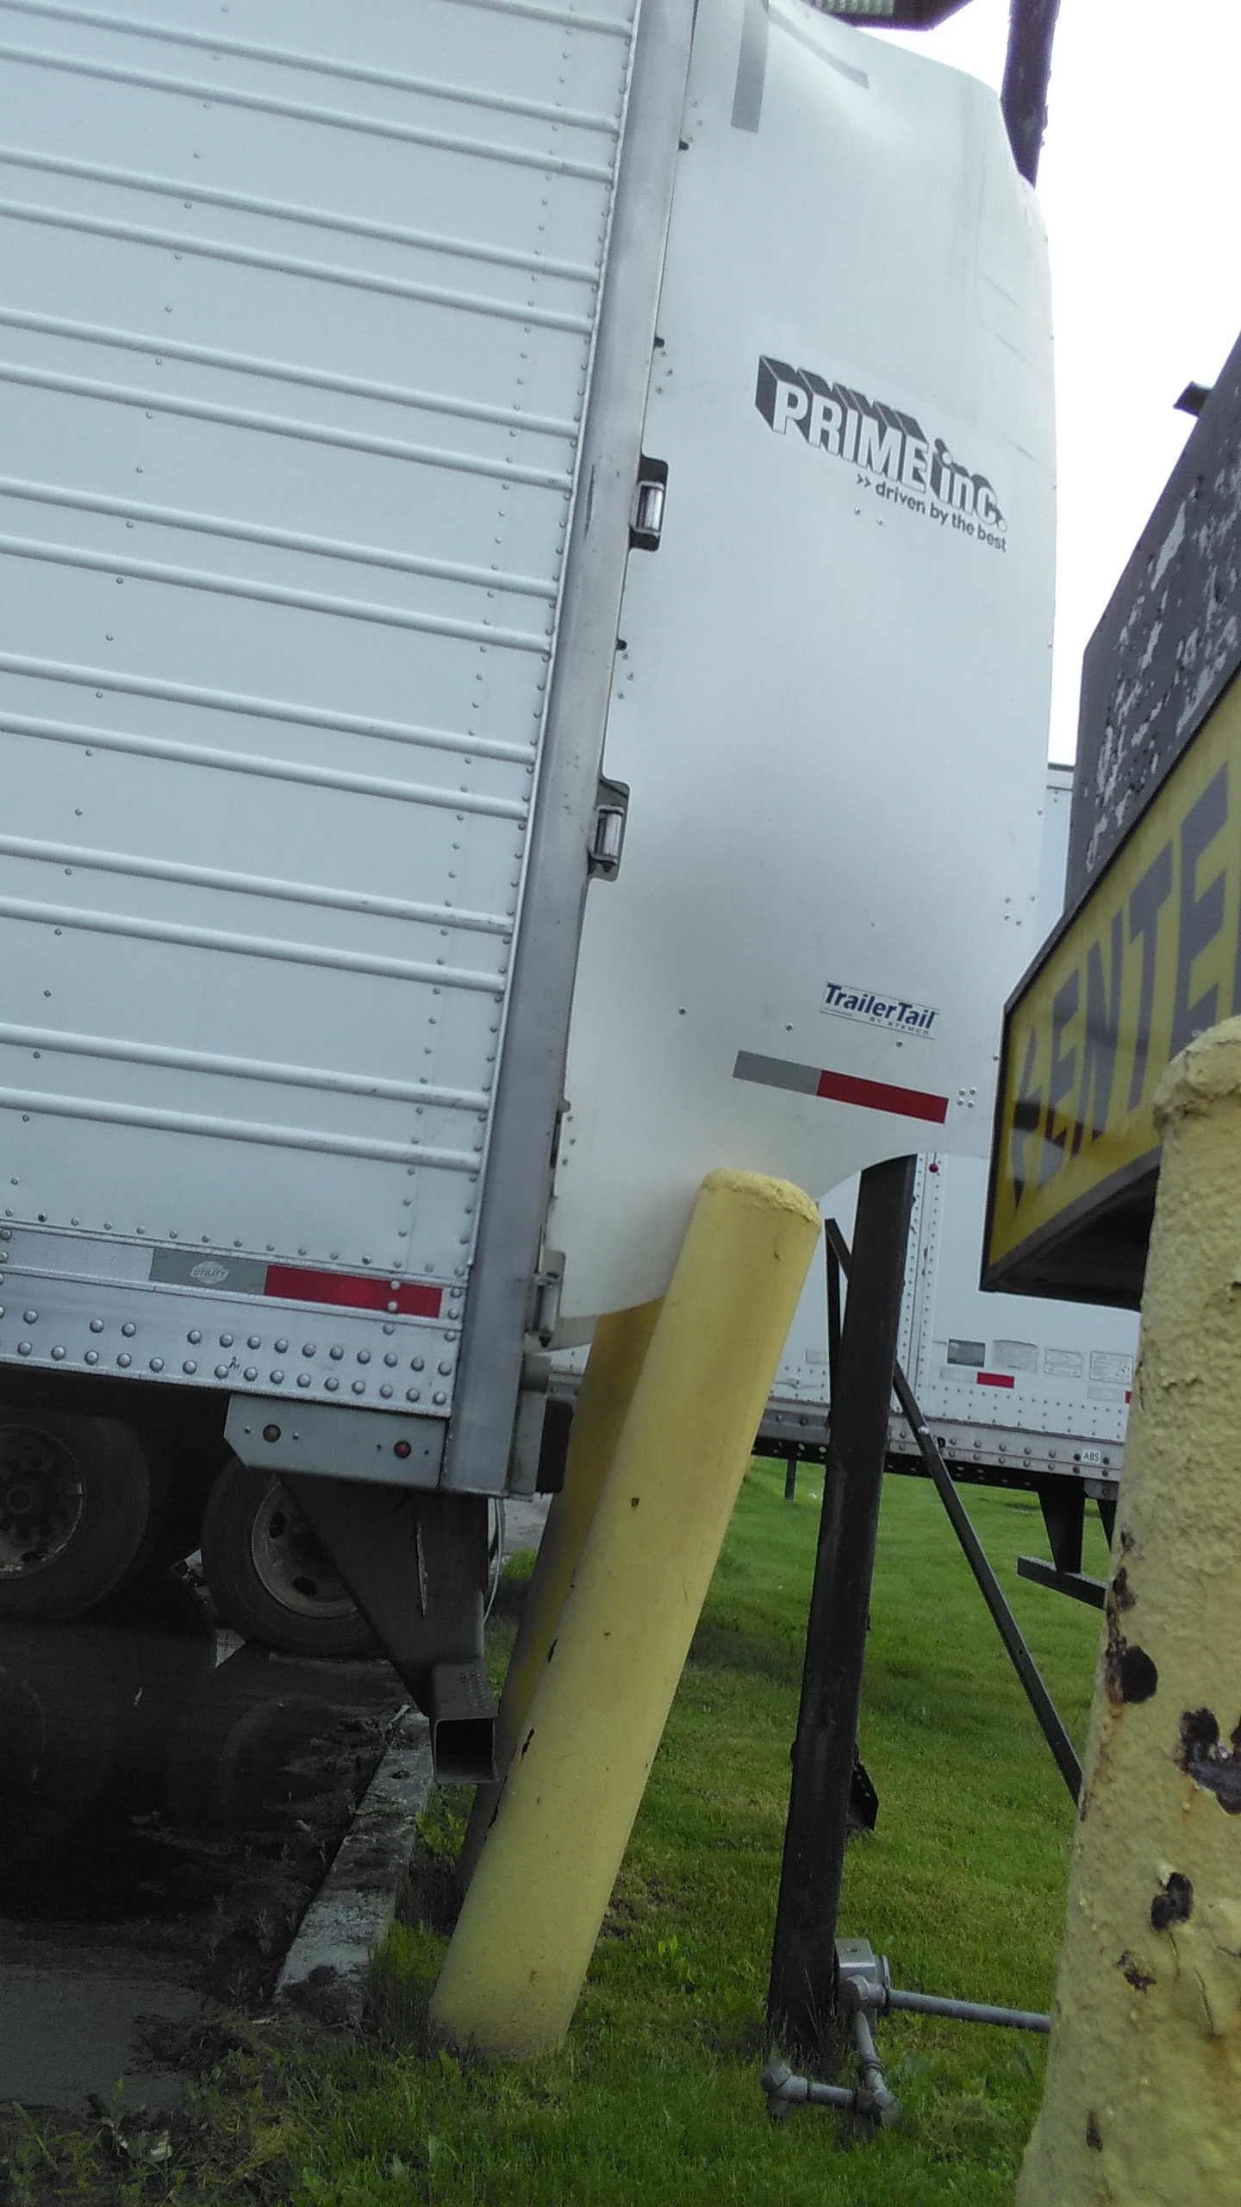
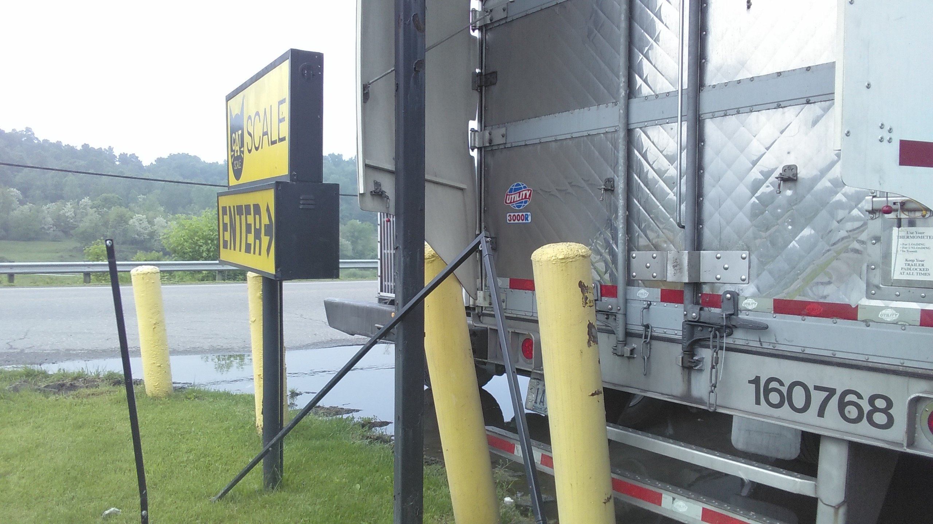
FM 727 Property Damage:
On 05/18/2019 a semi driver backed into bollard and light post. Lights stopped working. Driver refused to provide information and became verbally abusive to FM staff. FM called Sheriff’s. Sheriff required to provide information. Sheriff cited driver with improper backing.

Slide 6
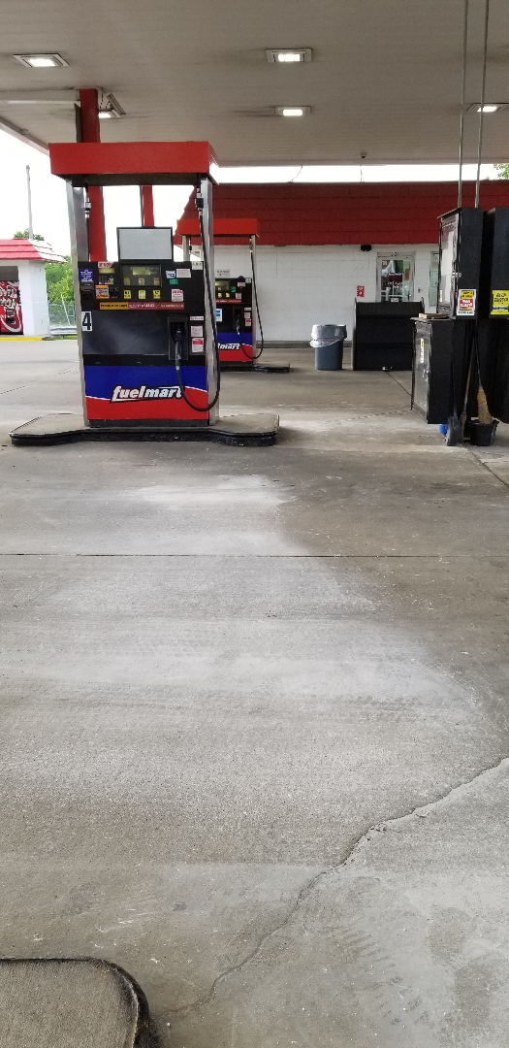
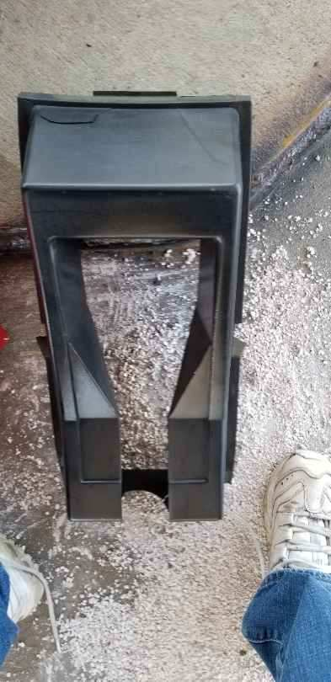
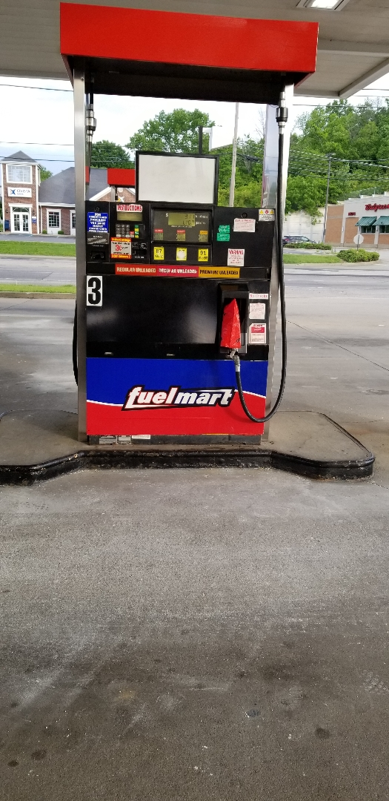
FM 648 Property Damage:
On 05/18/2019 customer trailer struck the gas pump causing damage and a spill.

Slide 7
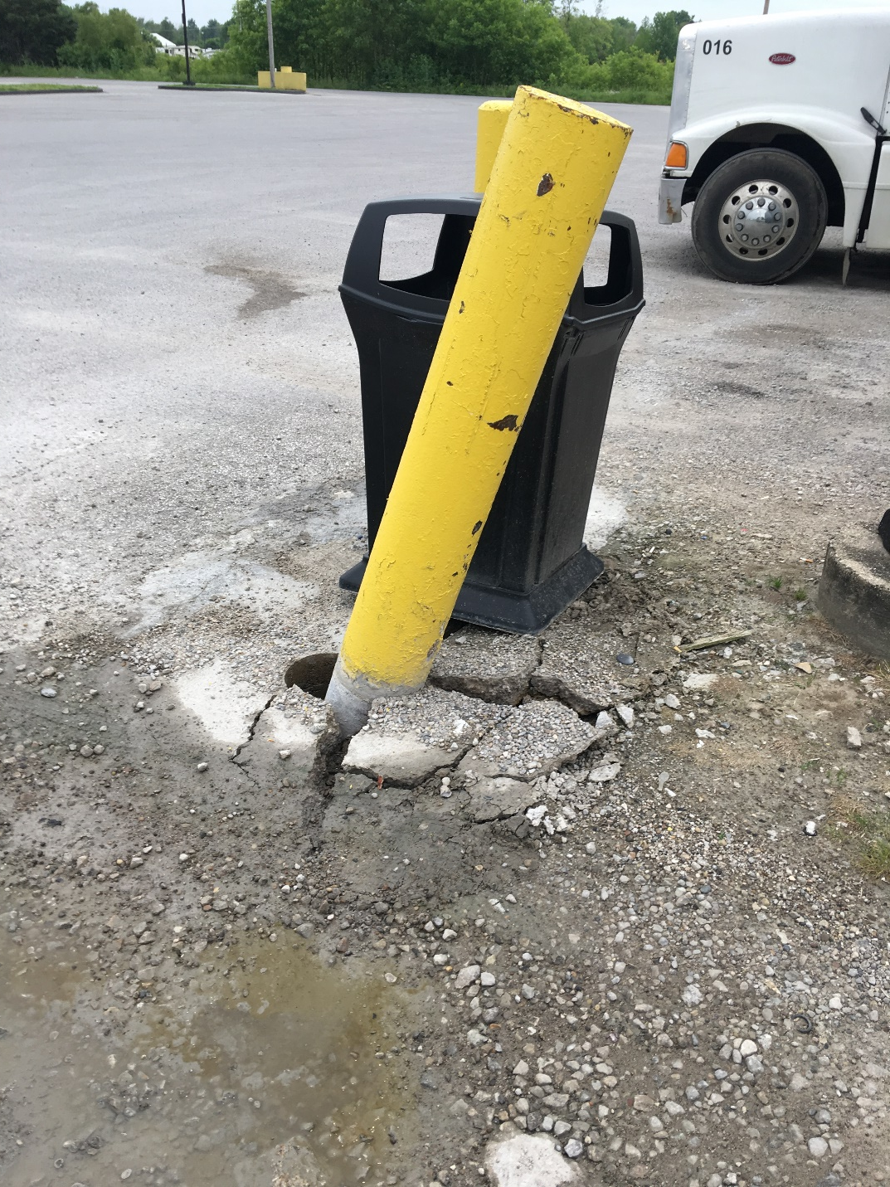
FM 783 Property Damage:
On 05/20/2019 vehicle struck bollard protecting the light pole in semi-trailer parking lot. Unable to determine who caused the damage.

Slide 8
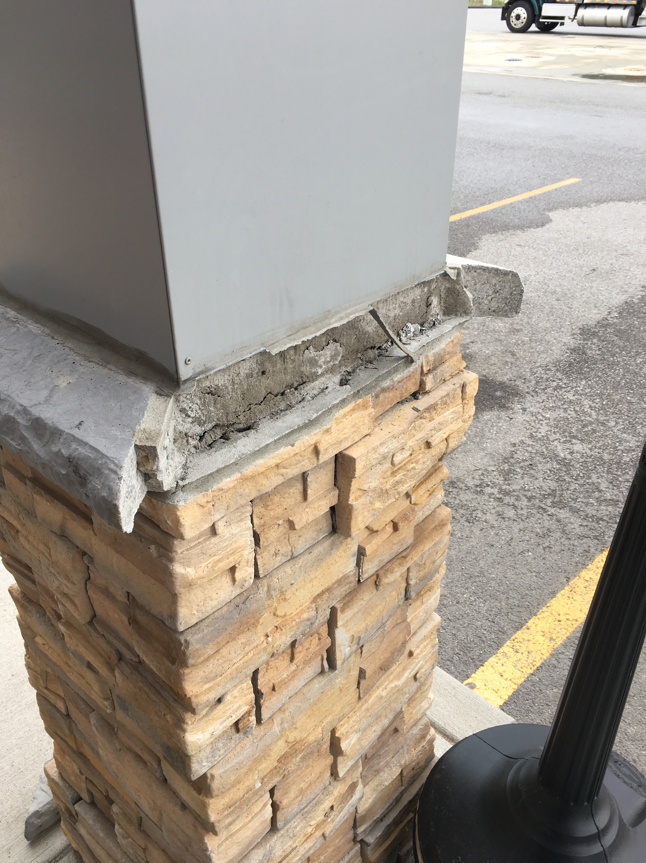
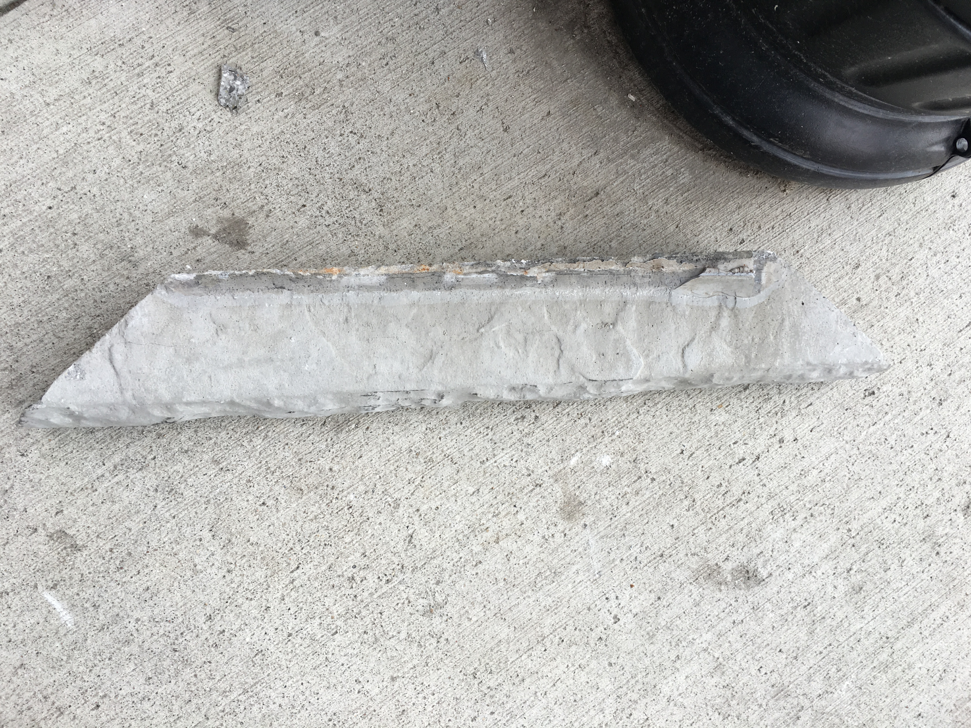
FM 767 Property Damage:
On 05/22/2019 a Coca-Cola delivery driver struck an outside building pillar with a cart of coke knocking off a piece of decorative stone.

Slide 9
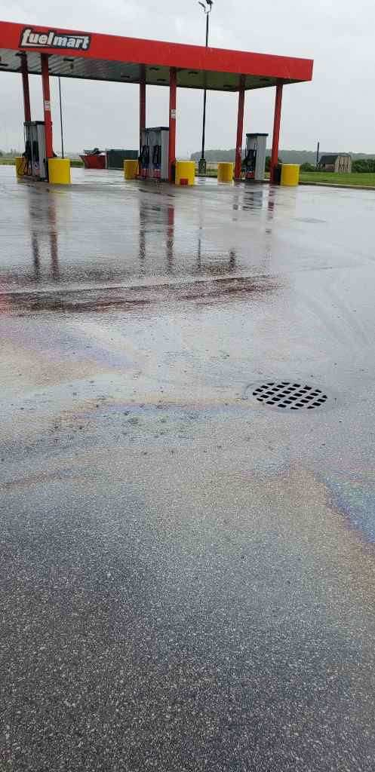
FM 764 Property Damage:
On 06/13/2018 FM employee noticed the diesel island drains were backed up creating a petroleum sheen on the pavement. The water then entered another drain on FM property which is an underground holding tank. Vac truck arrived, started pump out and water started going down the drain. Three weeks prior they had a pump out, but the holding tank probably was not completely pumped out. Maintenance rectifying the issue with the company to try and prevent similar issues in the future.

Slide 10
FM customer Incidents:
05/21/2019 – customer tripped over the concrete around the island. Customer was ok.
No photos received. Please ensure you always take photos of the area so we can determine
if our property was properly maintained at the time of the incident.

Slide 11
Date Range: Jan. 01, 2019 – June 17, 2019 Company Total Incidents: 74 FuelMart & Subway Total Incidents: 42 FuelMart & Subway employee injuries Reported: 10 FuelMart Property Damage and/or Vehicle Incidents: 13 FuelMart Customer Spills: 7 (5 at fuel pumps) FuelMart & Subway Customer injuries reported: 9 Other Incidents: 3

Slide 12
Operation Safe Driver Week Sun., July 14 through Sat. July 20, 2019
According to National Highway Traffic Safety Administration (NHTSA) data, in 2017, speeding was a contributing factor in 26 percent of all traffic fatalities.
Comprised of all law enforcement jurisdictions (local police, county sheriffs, state highway patrol, and DOT officers). The initiative focuses on both passenger vehicles and CMVs.
Looking for:
Speeding Distracted Driving Texting Following too close
Reckless or aggressive driving Failure to obey traffic control devices
No seatbelt usage Other dangerous driving behaviors

Slide 13
Safety Topic

Slide 15
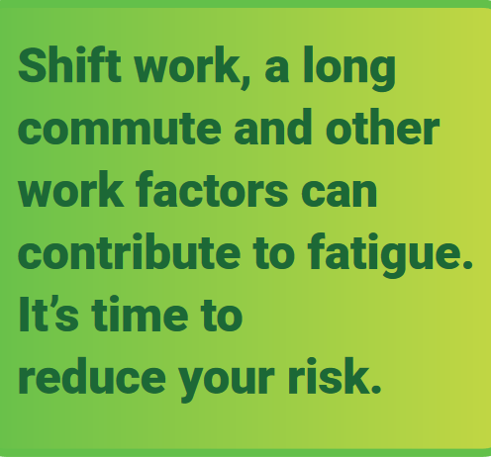
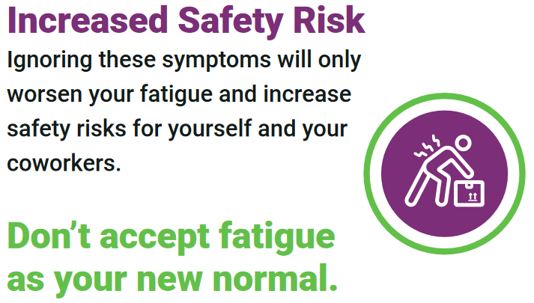

Slide 16
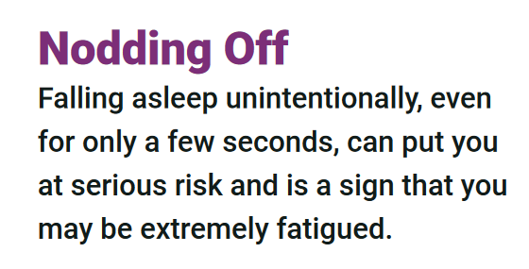

Slide 17
Open Floor Safety Questions / Concerns
Next Safety Committee Meeting is Wednesday, July 24, 2019 at 2:00 PM Eastern

